Slide 1
Public Forum on Regionalism
Potential Legislation
Evolving role of
Metropolitan Planning Organizations (MPO)
Getting Personal

Slide 2
In the past, the traditional role of an MPO was:
Allocation of transportation funding
Clean air and water as related to transportation
However, their evolving role covers far more,
For example – grants provided through the
Transportation Livability Communities Initiative
Megaregions
In most cases MPOs are run by unelected individuals

Slide 3
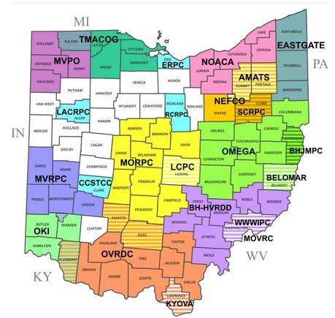

Slide 4
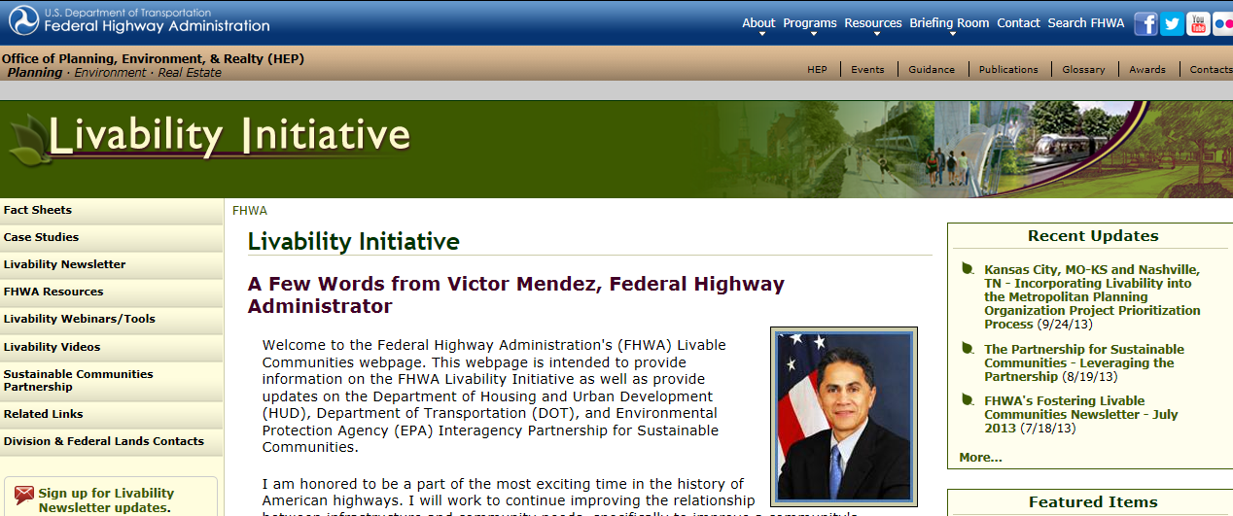
Transportation Livability Communities Initiative
“Consultants shall assemble a project team and work
with TLCI sponsors & NOACA to develop a scope of
services consistent with NOACA’s long-range
transportation goals and the TLCI objectives.”
http://noaca.org/tlcirfq2014.pdf
http://www.fhwa.dot.gov/livability/

Slide 5
Through the administration of TLCI grants
NOACA can greatly widen their influence
in sustainable development activities.

Slide 6
Transportation & land-use plans
Complete streets; bicycle & pedestrian network
Transit oriented development (TOD)
Reinvestment in underutilized or vacant properties
Environmental justice
Collaboration between regional & community partners
http://noaca.org/tlcirfq2014.pdf

Slide 7
MPOs…that receive FTA planning funds are expected
to incorporate Livable Communities elements into
their regular planning work programs.
Elements include applicable zoning and land use
policies such as higher density considerations,
mixed use guidelines, parking management, and
pedestrian/bicycle transit oriented design
standards.
Property acquisition, restoration or demolition
Purchase buses; enhancements to transit stations
Lighting, surveillance, community police, security
Sidewalks, aerial walkways, kiss & ride facilities
Transit marketing & pass programs
http://www.fhwa.dot.gov/publications/publicroads/00mayjun/liability.cfm
http://ntl.bts.gov/DOCS/livbro.html

Slide 8
Encourage fuel and energy conservation
Promote healthier communities from an integrated transportation perspective
Preserve and enhance farmland, forests, and open space
Assist the redevelopment of urban core communities
Enhance the historic, archaeological, scenic, and environmental elements of the transportation system
Improve the safety, efficiency, and quality of the existing transportation system
http://theciviccommons.com/issues/transportation-for-livable-communities-initiative

Slide 9
Enhance the economic vibrancy of existing communities within the region
Enhance a community’s identity
Promote compact, mixed land use development/redevelopment
Increase transportation choices through adding or improving pedestrian, transit, or bicycle facilities
Reduce air and water pollution through best management practices
http://theciviccommons.com/issues/transportation-for-livable-communities-initiative

Slide 10
Like bicycle paths?
Be careful what you wish for.

Slide 11
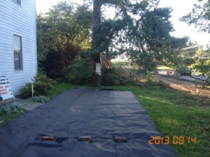
Home of Jennie Grenato in Montgomery County
Courtesy of the
Miami Valley Regional Planning Commission

Slide 12
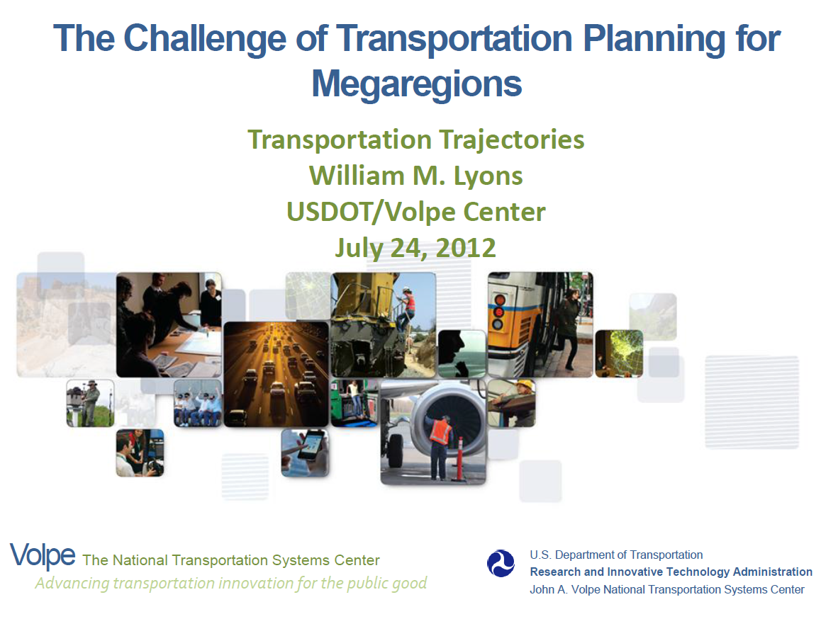
This document outlines the extensive
involvement of MPOs in regional planning.
http://www.volpe.dot.gov/noteworthy/docs/wlyons_volpe_megaregions.pdf

Slide 13
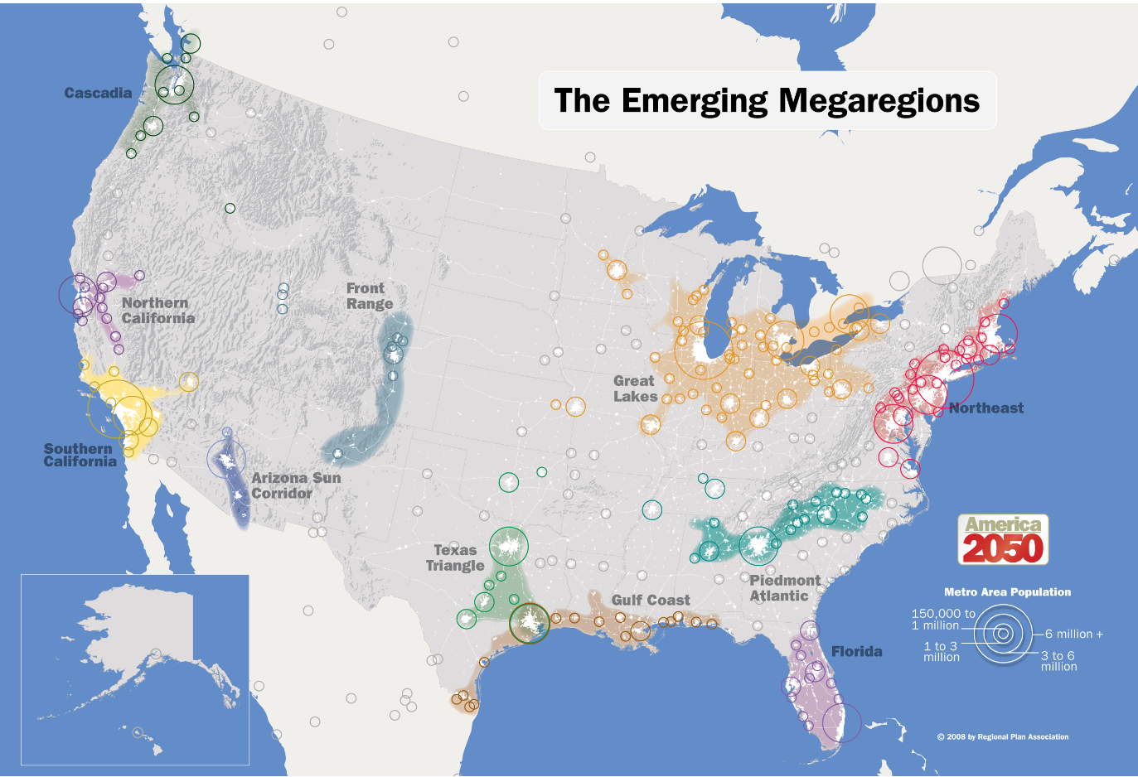
Megaregions:
“Large networks of metropolitan centers and
surrounding areas connected thru cultural,
environmental, economic characteristics
as well as infrastructure.”
http://www.america2050.org/images/2050_Map_Megaregions2008_150.png

Slide 14
Now, getting personal
If you haven’t already done so, I encourage you to pick a
cause and give it your best effort to make a difference.
I hope you might be interested in our cause, Agenda 21.
Following are some of the reasons why:

Slide 15
Regional planners and many levels of government make
use of Public Private Partnerships. Some call it picking
winners and losers. Others call it cronyism.
Where I come from, it’s called corruption.
We continue to hear about global warming, the polar
bears becoming extinct and the artic ice disappearing.
Forget that the global temperature hasn’t risen much
in the last 15 years. Some call it global warming. Others
call it climate change.
Where I come from, it’s called weather.

Slide 16
Federal agencies and regional proponents lecture on the
need for new regulations and zoning on land use, housing,
climate change, transportation and more. They call it
social and environmental justice.
Where I come from it’s unconstitutional, income
redistribution and social engineering.
The Department of Education wants to take control away
from parents, school boards and local communities. They
teach our children to become “citizens of the world.”
They call it Common Core.
Where I come from it’s called
dumbing down and brainwashing.

Slide 17

Let me show you why I’ve picked Agenda 21 as
my cause. When they’re old enough to understand,
I want to be able to tell them I gave it my best effort
to make a difference.
Where I come from it’s called family.

Slide 18
Where do you come from?
Find a cause and
make a difference.
www.davidfrost.org

