Slide 1
……nor be deprived of life, liberty, or property,
without due process of law; nor shall private
property be taken for public use, without just
compensation.
Amendment V The Constitution of the United States

Slide 2
"Land...cannot be treated as an ordinary asset, controlled by individuals and subject to the pressures and inefficiencies of the market. Private land ownership is also a principal instrument of accumulation and concentration of wealth, and therefore, contributes to social injustice; if unchecked, it may become a major obstacle in the planning and implementation of development schemes. The provision of decent dwellings and healthy conditions for the people can only be achieved if land is used in the interests of society as a whole. Public control of land use is therefore indispensable....”
Preamble 1976 UN Conference on Human Settlements – page 28
http://www.unhabitat.org/downloads/docs/924_21239_The_Vancouver_Declaration.pdf

Slide 3
Gro Harlem Brundtland
Prime Minister of Norway
In 1987 she chaired the World Commission on the
Environment and Development―the Brundtland
Commission established the concept of sustainable
development in its landmark report, Our Common Future.
The commission’s recommendations provided the
momentum for the United Nations Earth Summit in
Rio de Janeiro in 1992.

Slide 4
Vice Chair of World Socialist Party
“The Socialist Party stands for a fundamental transformation of the economy, focusing on production for need not profit. So-called fair trade is meaningless as long as the world economy is dominated by a few massive corporations. Only a global transformation from capitalism to democratic socialism will provide the conditions for international peace, justice, and economic cooperation based on the large-scale transfer of resources and technology from the developed to the developing countries.”
http://socialistparty-usa.net/platform.html

Slide 5
Report of the World Commission on Environment
and Development: Our Common Future
“Sustainable development is development
that meets the needs of the present
without compromising the ability of future
generations to meet their own needs.”
http://www.un-documents.net/wced-ocf.htm
“Consider the case in which 25 per cent of the incremental
income of the richest one-fifth of the population is
redistributed equally to the others. “
http://www.un-documents.net/ocf-02.htm#1

Slide 6
For the first time, tied poverty to climate change,
global warming, redistribution
“Poverty is a major cause and effect of global environmental problems. It is therefore futile to attempt to deal with environmental problems without a broader perspective that encompasses the factors underlying world poverty and international inequality.”
But, it’s only a UN report, right?
http://www.un-documents.net/our-common-future.pdf
“…to achieve the goals of sustainable development, good environment, and decent standards of life for all involves very large changes in attitude.”
Stanley Clinton-Davis
Commissioner for Environment European Economic Community
WCED Public Hearing Oslo, 24-

Slide 7
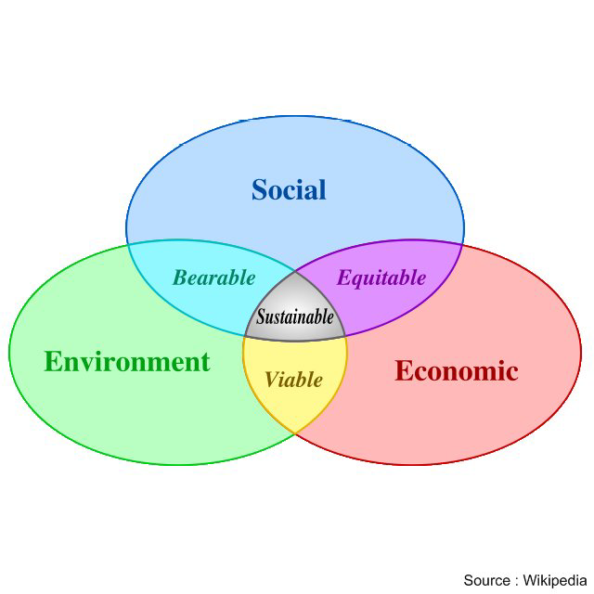
Three Pillars of Sustainable Development
Individual gives up needs
for the community
Nature over
man
Free Markets to Public Private Partnerships
International Wealth Transfer

Slide 8
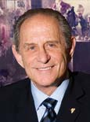
Social
Harvey Ruvin Vice President ICLEI
Under Sustainable Development individual human
wants, needs, and desires are to be conformed to
the views and dictates of social planners. Harvey
Ruvin, Vice Chair of the International Council on
Local Environmental Initiatives (ICLEI) said:
“individual rights will have to take a back seat to
the collective” in the process of implementing
Sustainable Development

Slide 9
Economic
Public Private Partnerships
PPP
Tax Breaks
Limited Liability
Easy Access to Fed $
Monopolies
Subsidies
Large Contracts
Free Enterprise
High Taxes
Normal Liability
Limited Access
High Competition
High Cost of Money
Struggle to Survive
Solyndra
Brazil
Fisker
GM/Chrysler/GE

Slide 10
International Wealth Transfer
Economic
Earth Summit 1992
Agenda 21 Preamble Chapter 1.4
The developmental and environmental
objectives of Agenda 21 will require a substantial flow of
new and additional financial resources to developing
countries, in order to cover the incremental costs for the
actions they have to undertake to deal with global
environmental problems and to accelerate sustainable
development. Financial resources are also required for
strengthening the capacity of international institutions for
the implementation of Agenda 21.
http://www.un-documents.net/a21-01.htm

Slide 11
Environmental Justice
Environment
common usage describes a social
movement whose focus is on the fair
distribution of environmental benefits and burdens.
Principle 8. Reduction of Unsustainable Patterns of
Production and Consumption
To achieve sustainable development and a higher quality
of life for all people, States should reduce and eliminate
unsustainable patterns of production and consumption
and promote appropriate demographic policies
1992 Rio Declaration on Environment and Development

Slide 12
337 ski runs
350 grazing of livestock
351 disturbance of soil
350 large hoofed animals
350 compaction of soil
351 fencing of pastures
728 agriculture
728 modern farm systems
728 chemical fertilizers
728 herbicides
728 building materials
730 industrial activities
730 human-made caves
730 paved roads
730 railroads
730 floor & wall tiles
733 aquaculture
733 technology improvements
733 farmlands
733 pastures, rangelands
733 fish ponds
733 plantations
738 modern housing
738 timber harvesting
738 modern hunting
749 logging activities
728 fossil fuels
755 dams, reservoirs
755 straightening rivers
757 power line construction
763 inappropriate social structures
763 legal & institutional systems
766 Judaeo-Christian-Islamic religions
767, 782 private property
771 population growth
773 consumerism
774 habitat fragmentation
774 sewers, pipelines
783 land that serves human needs
969 fisheries
970 golf courses
728 synthetic drugs
993 wildlands map

Slide 13
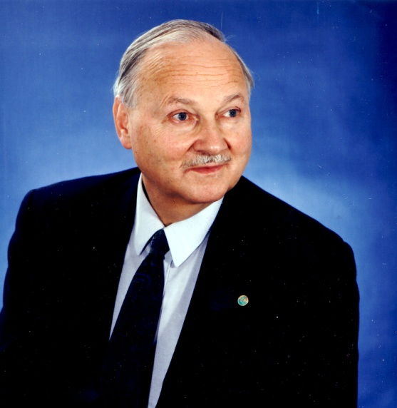
These conferences led to 1992 Earth Summit in Rio
178 countries 17000 participants 8000 media
Secretary General of the 1992 UN
Conference on Environment and
Development --the so-called Earth
Summit -- held in Rio de Janeiro, which
gave a significant push to global economic
and environmental regulation.
Maurice Strong
“Current lifestyles and consumption patterns of the
affluent middle class – involving high meat intake,
the use of fossil fuels, electrical appliances, home
and work-place air-conditioning, and suburban housing –
are not sustainable. “
Opening speech by Maurice Strong

Slide 14
“What if a small group of world leaders were to
conclude that the principal risk to the Earth
comes from the actions of the rich countries?
And if the world is to survive, those rich countries would
have to sign an agreement reducing their impact on the
environment. Will they do it? The group's conclusion is 'no'.
The rich countries won't do it. They won't change. So, in
order to save the planet, the group decides:
Isn't the only hope for the planet that the industrialized
civilizations collapse? Isn't it our responsibility to
bring that about?”
Maurice Strong, Interview 1992

Slide 15
Agenda 21 codified the Global Biodiversity Assessment
“Agenda 21 is a comprehensive plan of action to be taken
globally, nationally, and locally by organizations of the
United Nations System, Governments, and Major Groups in
every area in which human impacts (sic) on the
environment.”
But it’s just a UN report, right?
http://sustainabledevelopment.un.org/index.php?page=viw&nr=23&type=400&menu=35

Slide 16
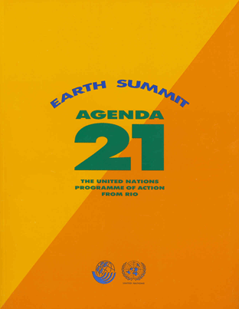
http://www.un-documents.net/agenda21.htm

Slide 17
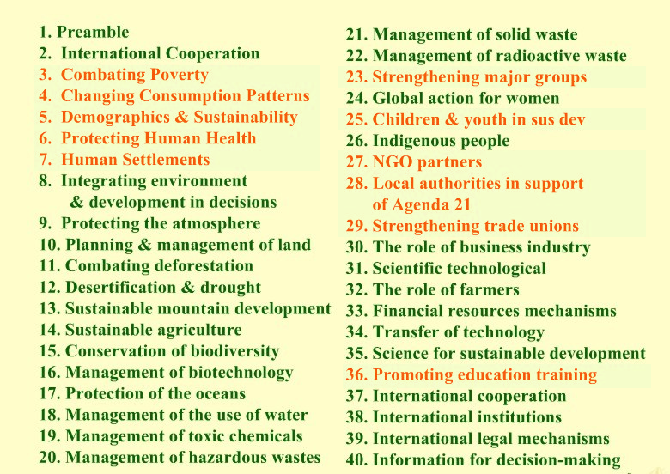

Slide 18
Bringing it to the United States
In 1992 President George H. W. Bush signed what is commonly referred to as the "Rio Accords."
In 1993 newly-elected President Bill Clinton created "The President's Council on Sustainable Development" through Executive order#12852.
The United States is a signatory country to Agenda 21, but because Agenda 21 is not a treaty, the United States Senate has not held a formal debate or vote.
(voluntary, not binding?)

Slide 19
http://clinton2.nara.gov/PCSD/
Established Executive Order 12852 June 29, 1993
Abolished Executive Order 23238 Sept. 30, 1999
The EO directed all agencies of the Federal Government to work with state and local community governments in a joint effort “reinvent” government using the guidelines outlined in Agenda 21.
“The Sustainable Development Challenge Grant program is also a step in
implementing Agenda 21, the Global Plan of Action on Sustainable Development
signed by the United States at the Earth Summit in Rio de Janeiro in 1992”
Federal Register, Volume 63, Number 163, Aug. 24 1998

Slide 20
1998
“The Sustainable Development Challenge Grant Program is
also a step in implementing “Agenda 21, the Global Plan
of Action on Sustainable Development” signed by the
United States at the Earth Summit In Rio de Janeiro in 1992”
Federal Register August 24, 1998 Volume 63, Number 163 p 45155-45161

Slide 21
Hiding Agenda 21 from the people
In the case of the U.S., our local authorities are engaged in planning processes consistent with Local Agenda 21, but there is little interest in using the Local Agenda 21 brand. Participating in a U.N. advocated planning process would very likely bring out many of the conspiracy-fixated groups and individuals in our society such as the National Rifle Association, citizen militias and some members of Congress. This segment of our society who fear ‘one-world government’ and a U.N. invasion of the United States through which our individual freedom would be stripped away would actively work to defeat any elected official who joined ‘the conspiracy’ by undertaking Local Agenda 21. So, we call our processes something else, such as comprehensive planning, growth management or smart growth.
J. Gary Lawrence,
advisor to President Clinton’s Council on Sustainable Development

Slide 22
Hiding Agenda 21 from the people
“Participating in a UN Advocated planning
process would very likely bring out many of
the conspiracy-fixated groups and individuals
in our society………who would actively work to
defeat any elected official…undertaking Local
Agenda 21. So we call our process something else,
such as comprehensive planning, growth
management or smart growth”.
J. Gary Lawrence,
advisor to President Clinton’s Council on Sustainable Development

Slide 24
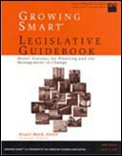
American Planning Association
Growing Smart – 1432 pages
Legislative Guidebook with Model Statutes
For Planning and the Management of Change
The Presidents Council on Sustainable Development
gave a multimillion dollar grant to the APA to
develop a planning and zoning template that would
support sustainable development
(APA “Glossary for the Public)
Does your planning department use the Growing Smart template?

Slide 25
The Precautionary Principle
“In order to protect the environment, the precautionary approach shall be widely applied by States according to their capabilities. Where there are threats of serious or irreversible damage, lack of full scientific certainty shall not be used as a reason for postponing cost-effective measures to prevent environmental degradation.”
United Nations Conference on Environment and Development.
Principle 15 of the Rio Declaration

Slide 26
20 Minute Communities
“In order to better connect housing to jobs,
the office will work to coordinate federal housing
and transportation investments with local land use
decisions in order to:…..”
Housing & Urban Development/Presidents Council on Sustainable Development

Slide 27
20 minute communities
In order to better connect housing to jobs, the office will work to coordinate federal housing and transportation investments with local land use decisions in order to reduce transportation costs for families, improve housing affordability, save energy, and increase access to housing and employment opportunities. By ensuring that housing is located near job centers and affordable, accessible transportation, we will nurture healthier, more inclusive communities which provide opportunities for people of all ages, incomes, races, and ethnicities to live, work, and learn together.

Slide 28
20 minute communities
reduce transportation costs for families
improve housing affordability,
save energy, and
increase access to housing and employment opportunities. ensuring that housing is located near job centers and affordable, accessible transportation
nurture healthier, more inclusive communities which provide opportunities for people of all ages, incomes, races, and ethnicities to live, work, and learn together.
Housing & Urban Development/Presidents Council on Sustainable Development

Slide 29
20 minute communities
"...Community Sustainability Infrastructures [designed for] efficiency and livability that encourages: in-fill over sprawl: compactness, higher density low-rise residential: transit-oriented (TODs) and pedestrian-oriented development (PODs): bicycle circulation networks; work-to-home proximity; mixed-use-development: co-housing, housing over shops, downtown residential; inter-modal transportation malls and facilities ...where trolleys, rapid transit, trains and biking, walking and hiking are encouraged by infrastructures.“
Housing & Urban Development/Presidents Council on Sustainable Development

Slide 30
20 minute communities
efficiency and livability that encourages:
in-fill over sprawl
compactness, higher density low-rise residential
transit-oriented (TODs)
pedestrian-oriented development (PODs)
bicycle circulation networks **
work-to-home proximity
Housing & Urban Development/Presidents Council on Sustainable Development
**
U. S. Department of Transportation Recommended Actions
“Considering walking and bicycling as equals with other transportation modes;”
http://www.fhwa.dot.gov/environment/bicycle_pedestrian/overview/policy_accom.cfm

Slide 31
20 minute communities
efficiency and livability that encourages:
mixed-use-development:
co-housing,
housing over shops,
downtown residential;
inter-modal transportation malls and facilities for trolleys, rapid transit, trains, biking, walking, hiking
Housing & Urban Development/Presidents Council on Sustainable Development

Slide 32
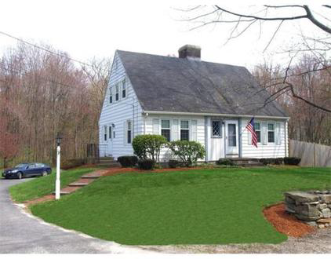
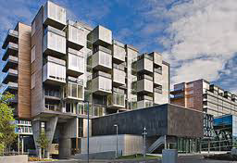

Slide 33
“In 2010, EPA commissioned a landmark study
from the National Academies to provide
recommendations on how to systematically
operationalize the concept of sustainability
into all the Agency’s decision making.”
$700,000
694
“Perhaps the most significant step take on EPA’s Path
Forward has been the strategic realignment of Agency
Research efforts around the concept of sustainability.”
http://pubs.acs.org/doi/abs/10.1021/es203881e
http://www.nap.edu/openbook.php?record_id=13152&page=35

Slide 34
Education

Slide 35
http://unesdoc.unesco.org/images/0014/001416/141629e.pdf

Slide 36
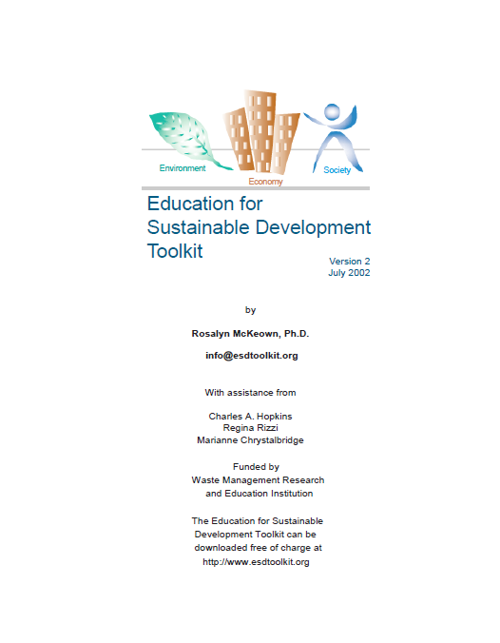
“Generally, more highly
educated people, who
have higher incomes,
consume more resources
than poorly educated
people, who tend to have
lower incomes. In this case,
more education increases
the threat to sustainability.”
www.esdtoolkit.org
Page 10
www.esdtoolkit.org

Slide 37
“Two of the major issues in the international dialog on sustainability are population and resource consumption. Increases in population and resource use are thought to jeopardize a sustainable future, and education is linked both to fertility rate and resource consumption. Educating females reduces fertility rates and therefore population growth. By reducing fertility rates and the threat of overpopulation a country also facilitates progress toward sustainability. The opposite is true for the relationship between education and resource use. Generally, more highly educated people, who have higher incomes, consume more resources than poorly educated people, who tend to have lower incomes. In this case, more education increases the threat to sustainability.”
Education for Sustainable Development Toolkit Page 10

Slide 38
Education for Sustainable Development Toolkit Page 88

Slide 39
North American Association for Environmental Education
http://www.naaee.net/
Early Childhood Environmental Education Programs: Guidelines for Excellence (NAAEE 2010), the newest addition to the continuing guidelines series, contains a set of recommendations for developing and administering high-quality environmental education programs….
for young children from birth to age eight,
with a focus on ages three to six.
“When one side only of a story is heard and often repeated,
the human mind becomes impressed with it insensibly.”
George Washington, letter to Edmund Pendleton, Jan. 22, 1795

Slide 40
Bringing it to northeast Ohio

Slide 41
Regional Governance in Northeast Ohio
A Definition
&
A Timeline

Slide 42
REGIONALISM
Regional governance is the process by which people in a region determine and pursue their collective ends, means, and values.
Regionalism evolved as a way to get around the obstacles presented by multiple local governments, all of which have a stake …
Strategies vary, but the basic idea is to help a region thrive by forcing a city and its suburbs to work together toward the common good.
http://www.hrp.org/Site/index.php?option=com_content&view=article&id=158:regional-definition
http://www.renewamerica.com/columns/lamb/111031
http://www.cleveland.com/region/plaindealer/index.ssf?/region/more/comparison.html

Slide 43
Regional Governance
Driven by government, not by the people
Seeks to increase power & overcome any
obstacle in its path
When governments disagree on how best
to solve a common problem:
ie.Allocation of highway funds;
federal & state grants, etc.
Regional “governance” may be proposed/imposed

Slide 44
Regional Governance
Destroys traditional political boundaries
Diminishes the power of local governments
Confers increasing levels of authority on the
executive branch
Implements authority thru appointed
bureaucrats
Causes elected officials to become little
more than a rubber stamp

Slide 45
Cleveland-area planners suggested revenue sharing –access to taxes collected by surrounding suburbs. They also cited the “urban growth boundary” in Portland, OR
2006
2007
Proposal to convert Metropolity Planning Organizations (MPOs) into regional planning commissions
MPOs were created to manage federal transportation dollars, air & water quality

Slide 46
2008
House Speaker Armond Budish (D) pledged to
enact a bold regionalist agenda across the state
Mayors and city planners establish the Regional Prosperity Initiative (RPI) for 16 NE OH counties and consolidation of 4 MPOs into a single regional planning agency. A key element of the proposal was revenue sharing.
2009
The Obama administration hailed the
RPI proposal as a national model

Slide 48
Sustainable Communities Initiative
Key policy in the Obama Administration’s
regionalist policy
Federal dollars for transportation, housing
and land use
On condition the plans are regional in scope
& managed by regional governing bodies
http://www.sustainablecommunities.gov/
Spreading the Wealth: How Obama is Robbing the Suburbs to Pay for the Cities’ by Stanley Kurtz (Page 33)

Slide 49
Eastgate Regional Council of Governments
Planning organization
for Ashtabula, Trumbull & Mahoning Counties
Allocation of transportation funds
Water quality
Air quality
http://www.eastgatecog.org/

Slide 50
2010
NOACA & RPI created Northeast Ohio Sustainable Communities Consortium. NEOSCC received $4.25 million grant from Sustainable Communities Initiative (+ in kind $ almost $2.0 million)
“…to create a regional development plan … for the region by connecting housing with good jobs, quality schools and transportation.”
“…sustainable growth plan… to develop transportation policies that encourage clustered development and improve mass transit options.”
The Post Newspapers Saturday April 9, 2011

Slide 51
http://vibrantneo.org/

Slide 52
“The sustainable growth plan is also expected to produce recommendations to achieve these goals:”
reduce redundancy
encourage new sources of energy
build regional consensus around smart growth implications on local zoning
eliminate the zero-sum competition among the regions political subdivisions by creating a sustainable tax base for all communities through coordinated land use planning
The Post Newspapers Saturday April 9, 2011

Slide 53
NEOSCC Hires Consultants
Who are they?
What is their focus?
How do they fit in regional
governance objectives?

Slide 54
Sasaki Associates Watertown MA
http://www.sasaki.com/
Fregonese Associates Portland OR
http://www.frego.com/
City Architecture Cleveland OH
http://cityarch.com/
Nelson Nygaard San Francisco CA
http://www.nelsonnygaard.com/

Slide 55
Inclusionary Zoning

Slide 56
Inclusionary Zoning
“requirement for a given share of new construction..a mix of affordable housing and market rate housing in the same neighborhood”
“…a community should adopt a mandatory inclusionary zoning regime.”
“…should create a comprehensive plan based
upon a “fair share” of the regional need for such housing.”
http://lawdigitalcommons.bc.edu/cgi/viewcontent.cgi?article=1092&context=ealr
http://humboldtherald.wordpress.com

Slide 57
URBAN
GROWTH
BOUNDARIES
(UGBs)

Slide 58
Urban Growth Boundary - UGB
"The urban growth boundary (UGB) marks the separation between rural and urban land."
"Land inside the UGB supports urban services such as roads, sewer, water, parks, schools and fire and police protection that create thriving places to live, work and play."
THIS TERM IS NO LONGER IN FAVOR - LOOK FOR "UTILITY SERVICE AREA" OR SIMILAR LANGUAGE.
http://www.keepourrights.org/glossary.htm#Urban%20Growth%20Boundary
http://www.oregonmetro.gov/index.cfm/go/by.web/id=277

Slide 59
Urban Growth Boundaries
Because services such as roads, sewer, water, etc. will not be supplied to land on the outside of the UGB, it will become worth less, to be bought up at give-away prices by the environmental NGOs (non-governmental organizations) - a taking of ones property made possible through the actions of local government.
(vs the Kelo decision)
http://www.keepourrights.org/glossary.htm#Urban%20Growth%20Boundary

Slide 60
Other “Stakeholders”

Slide 61
“The International Council for Local Environmental Initiatives.
(ICLEI) Cities for Climate Protection Campaign. ICLEI
was instrumental in the adoption of Local Agenda 21 at the
Earth Summit. Agenda 21 identifies specific objectives
that can be used to guide sustainable development efforts.
Since then, the U.S. branch of ICLEI has helped local
governments assume a major role in sustainability efforts
and has developed .one-stop. guides on technical assistance
and funding sources, and other references.”
http://clinton2.nara.gov/PCSD/Publications/tsa.pdf

Slide 62
ICLEI - Local Governments for Sustainability
Our programs and projects advocate participatory,
long term, strategic planning processes that address
local sustainability, while protecting global common
goods.
This approach links local action and solutions
to the global challenges we are facing, and
therefore also links local action to global goals
and targets,…
http://www.iclei.org/index.php?id=global-themes

Slide 63
Our programs and projects advocate participatory, long term,
strategic planning processes that address local sustainability, while
protecting global common goods. This approach links local action and
solutions to the global challenges we are facing, and therefore also
links local action to global goals and targets, such as:
http://www.iclei.org/index.php?id=global-themes

Slide 64
ICLEI - Local Governments for Sustainability
Akron | No Olmsted | Warren
Alliance | Oberlin | W Salem
Brooklyn | Parma | Westlake
Canton | Rittman | Willoughby Hills
Cleveland | So Euclid | Youngstown
Kent | Stow
http://local2012.iclei.org/advocacy/

Slide 65
The city of Cleveland has an Office of Sustainability
http://www.city.cleveland.oh.us/CityofCleveland/Home/Government/CityAgencies/
http://planning.city.cleveland.oh.us/cwp/sus_oview.php

Slide 66
2011
Building One America (BOA)
In 2011 the White House hosted a BOA-organized conference attended by some OH politicians.
The conference touted Portland’s planning system and Minnesota regional tax-base sharing.
BOA has attempted to draw politicians from
inner-ring suburbs across Ohio into an alliance
with city-based legislators on regionalist
issues. (The Obama administration could then
condition federal-aid programs on adherence
to NEOSCC recommendations.)

Slide 67
Who was in the White House Meeting?
Georgine Welo Mayor South Euclid OH – Co-chair
Michael Summers Mayor Lakewood OH
John Powell Kirwan Institute Columbus OH
Michael Strautmanis Deputy Asst. to the President
Raymond LaHood Secretary US DOT
Cecelia Munoz White House Dir. Intergovernmental Affairs
Pete Rouse Senior Advisor to the President
Jon Carson White House Dir. Public Engagement

Slide 68
Building One America (BOA)
Michael Kruglik, Founder Building One America
Co-founder of the Chicago-based Alinsky group Gamaliel Foundation that recruited, hired, trained and paid Obama as a community organizer in South Side Chicago.
(Gamaliel’s website expressly states it grew out of the Alinsky movement.)

Slide 69
David Rusk, Founding President,
Building One America
“Sustained success requires moving poor
people from bad city neighborhoods to good
suburban neighborhoods and moving dollars
from relatively wealthy suburban
governments to poorer city governments.”
I have a copy of his PowerPoint presentation in Washington
“Changing the Rules of the Game”
There is a you tube at: http://www.youtube.com/watch?v=3hty8teX4us&feature=player_embedded
Covering another DC conference in 2009 with Valerie Jarrett

Slide 70
Robert Kleidman – Recording Secretary
Associate Professor of Sociology at Cleveland State University. Since joining the faculty at CSU, he has moved his focus to community organizing.
He has been working closely with organizers for Building ONE America to create a powerful group of local elected officials and other community leaders in established suburbs in Ohio.

Slide 71
Building One America
Has a goal to abolish the suburbs. They propose a long term three part plan:
Force suburban residents into densely packed cities
Move the poor out of cities
Implement “regional tax-base sharing”
https://buildingoneamerica.org/

Slide 72
First Suburbs Consortium
Bedford | East Cleveland | Parma Hts
Bedford Hts | Euclid | Shaker Hts
Berea | Fairview Park | South Euclid
Brook Park | Garfield Hts | University Hts
Brooklyn | Lakewood | Warrensville Hts
Brooklyn Hts | Maple Hts
Cleveland Hts | Parma
http://www.firstsuburbs.org/firstsuburbs/northeast.php

Slide 73
Goals of First Suburbs Consortium
Revenue Sharing
Regional pool of revenue from property taxes
Transportation Policy Reform
Housing Policy Reform
Affordable Housing; Mixed Housing
Reinvestment
Eliminate policies that reward new development
Combat Sprawl
Fordham Urban Law Journal Volume 29, Issue 4 Article 6 2001

Slide 74
http://www.sustainabilityconsortium.org/

Slide 75
The Wildlands Project
“We must make this place an insecure and
inhospitable place for Capitalists and their projects –
We must reclaim the roads and plowed lands,
halt dam construction, tear down existing dams,
free shackled rivers and return to wilderness
millions of tens of millions of acres of presently
settled land”
Dave Foreman Earth First

Slide 76
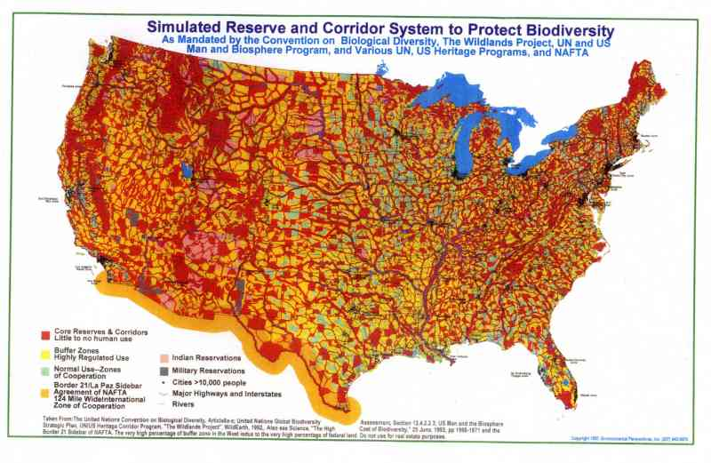

Slide 77
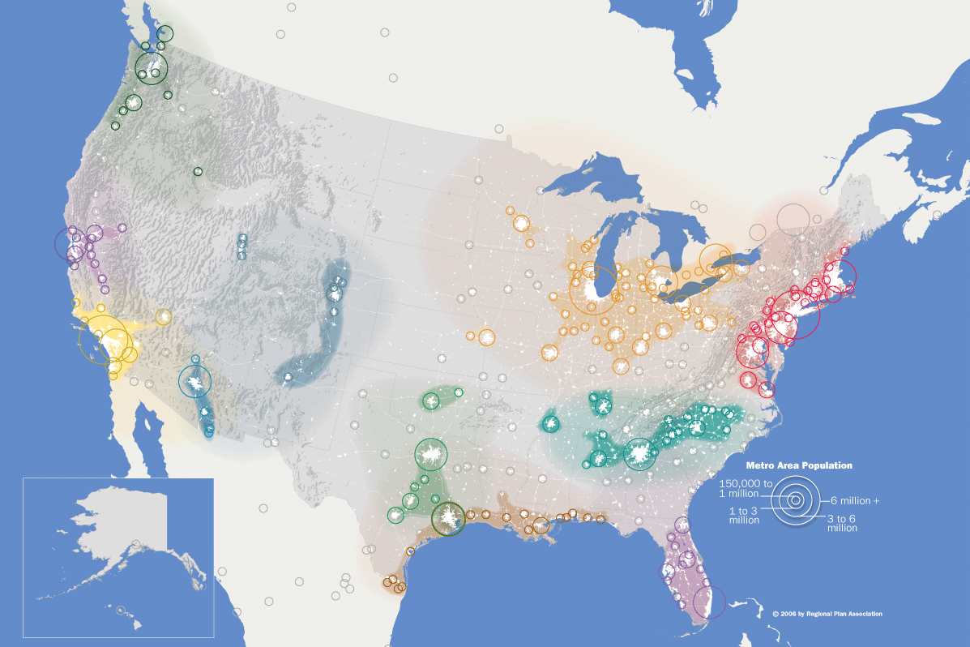
Notes:
77
…And the Emergence of Megaregions
Megaregions are large extended networks of metropolitan areas, connected by:
Large landscapes and topography
Overlapping commuting patterns
Linked economies
Land use patterns
Shared history and culture
We are looking to megaregions because:
Challenges occur at scale greater than metropolitan region
Compete with global integration zones
Coordinate major investments in infrastructure
Potential to organize federal policies

Slide 78
A transect is a cut or path through part of the
environment showing a range of different habitats.
Biologists and ecologists use transects to study the
many symbiotic elements that contribute to habitats
where certain plants and animals thrive.
http://www.transect.org/transect.html

Slide 79
http://www.transect.org/rural_img.html

Slide 80
SMARTCODE
Municipality SmartCode Version 9.2 SC5
1.6 Succession
1.6.1 Twenty years after the approval of a Regulating Plan, each Transect Zone, except the T1 Natural and T2 Rural Zones, shall be automatically rezoned to the successional (next higher) Transect Zone, unless denied in public hearing by the Legislative Body
http://www.transect.org/codes.html

Slide 81
Assessments of Impediments to Fair Housing
HUD requires that all cities and counties eligible
for Community Development Block Grant funding (entitlement communities) conduct an assessment of impediments to fair housing to certify compliance with the Consolidated Plan Final Rule, published in the Federal Register).
Federal Register (24 CFR 91.225
http://portal.hud.gov/hudportal/HUD?src=
/program_offices/fair_housing_equal_opp/promotingfh

Slide 82
HUD recently changed requirements for the
Assessments of Impediments to Fair Housing
to report on a regional basis…..but….
That is not meeting their expectations, so….

Slide 83
In April 2013 HUD intends to submit a new rule proposal targeting massive desegregation of each of the nation's more than 74,000 census tracts.
The plan …….will require that each census tract contain a similar percentage of minority families that now live in concentrated areas of a local/regional government's jurisdiction.
Each tract contains about 4,000 residents.
http://www.cdpublications.com/etc2/docfiles/hal/docs/
Unified%20agenda%202012.pdf
http://www.cdpublications.com/index.php?mod=fstory&ID=71

Slide 84
Fair Housing Forums
- sponsored by the NEOSCC
Regional AI Meeting, Ashtabula County
Wednesday March 13, 2013 @ 9:30 am - 11:30 am
Ashtabula County Head Start
Lake Erie Room
4510 Main Avenue
Ashtabula, OH
44104http://vibrantneo.org/vibrantneo-2040/fair-housing-forums/

Slide 85
http://vibrantneo.org/workshops/

Slide 86
VibrantNEO 2040’s scenarios will tell stories about our possible futures, based on where Northeast Ohio is today and the choices we might make about how we use our land and how we invest our resources. Once we create these scenarios, we will be able to compare how successful they are at achieving our common goals for the region, judge which choices would be best for Northeast Ohio’s future, and create a shared vision and framework for the future around those choices.
You are invited to attend an upcoming workshop to share your voice in the conversation. We have selected six city locations throughout the region for your convenience. Pick a date and location that works for you!
April 30, 2013 6:30 pm
For Mahoning, Trumbull & Ashtabula
Warren, OH (location TBD)
550,632

Slide 87
1,999,474
.000007

Slide 88
Kyoto Protocol
http://unfccc.int/kyoto_protocol/
Convention on
Desertification
http://www.unccd.int/
Convention on
Biodiversity
http://www.cbd.int/
Federal
Agencies
Clean Air Act
VOLUNTARY, NON-BINDING?
Endangered Species Act
Agenda 21
IUCN
WRI
Clean Water Act
Presidents Council on
Sustainable Development
NGO’S
Wetland Regulations
Changing of existing
laws & regulations
International Union for Conservation of Nature http://www.iucn.org/
World Resources Institute http://www.wri.org/
From YouTube - UNA21:The Evil Smart Growth Fraud

Slide 89
Your
Town?

Slide 90
“The goal of the planning will be described by
some vague term as “the general welfare”.
There will be no real agreement as to the ends to be
attained, and the effect….will be rather as if a group
of people were to commit themselves to take a
journey together without agreeing where they
want to go; with the result that they may all
have to make a journey which most of them
do not want at all.”
The Road to Serfdom by Friedrich A. Hayek 1944

Slide 91
www.davidfrost.org

